Slide 1
The Battle of Neighbourhoods
Apoorv Dixit

Slide 2
Problem Statement
A Restaurant Company is looking to open new restaurants in Toronto area. They are not able to narrow down the location options and suitable cuisine for the restaurants. The company wants to find out the most suitable location for the restaurant which is likely to get maximum customers possible. Along with the location, the company also wants to find out the best suitable Cuisine according to the locality which will enhance the chances of the attracting more customers.
The Company have below cuisine options for the restaurant:
Vegetarian / Vegan restaurant
Mexican restaurant
Indian restaurant
Japanese restaurant
Italian restaurant

Slide 3
Methodology
Data Collection:
Postal Codes Wikipedia
Geospatial data
Venue Data Foursquare API
Data Processing and Analysis:
Data merging
One hot encoding
KMeans clustering
Data visualization using maps and charts.
Final analysis and Recommendations

Slide 4
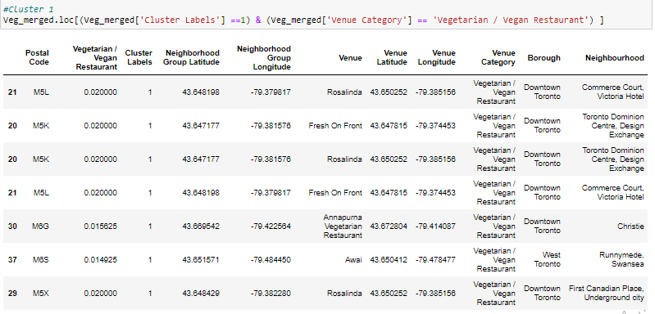
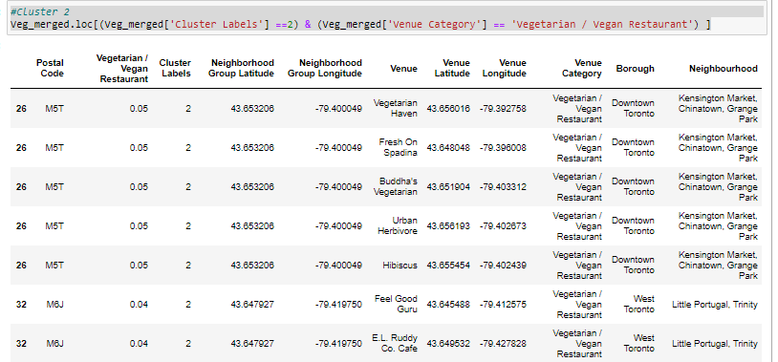
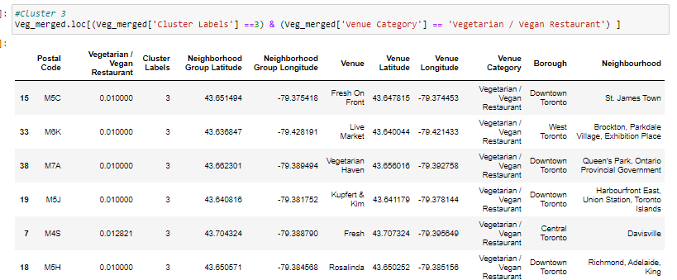
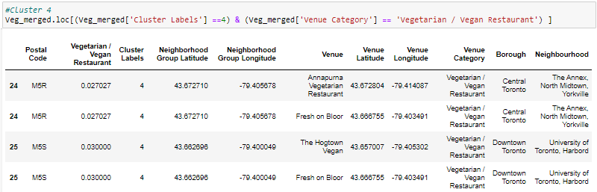
Clustering and Analysis
Sample for Veg/ Vegan Restaurants:
Cluster 0: No Veg Restaurants found
Cluster 1 is having many Veg/Vegan restaurants mainly in : The Beaches, D, avisville North, First Canadian Place, Commerce Court, Toronto Dominion Centre.
Cluster 2: The cluster 2 is having multiple Veg restaurants in the Neighbourhood : Kensington Market, Chinatown, Grange Park, Little Portugal, Trinity.
Cluster 3:
The cluster 3 is having multiple Veg restaurants in the Neighbourhood. Not recommended for new restaurant
Cluster 4:
Veg Restauant Recommendation:
Suitable Neighbourhood for Veg restaurant in cluster 4 are : University of Toronto, Harbord

Slide 5
Recommendation Summary
Restaurant Type | Recommended Neighbourhood
Vegetarian / Vegan Restaurant | Church and Wellesley The Danforth West, Riverdale Garden District, Ryerson' Studio District India Bazaar, The Beaches West University of Toronto, Harbord
Indian Restaurant | The Beaches , Runnymede The Junction, Weston- Pellam Park
Mexican Restaurant | Christie The Beaches
Japanese Restaurant | Moore Park, Summerhill East'
Italian Restaurant | Kensington Market, Chinatown, Grange Park The Beaches Runnymede, The Junction, Weston- Pellam Park Carlton Village Moore Park, Summerhill East Forest Hill North & West, Forest Hill Road Park

Slide 6
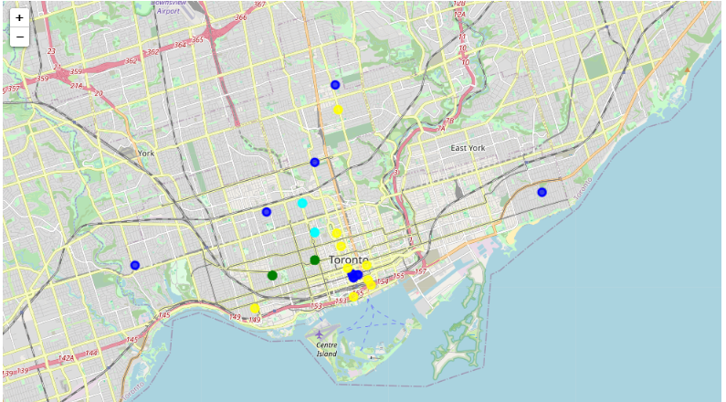
Vegetarian / Vegan Restaurant Clusters
Vegetarian / Vegan Restaurant Recommendations
Restaurant Type | Recommended Neighbourhood
Vegetarian / Vegan Restaurant | Church and Wellesley The Danforth West, Riverdale Garden District, Ryerson' Studio District India Bazaar, The Beaches West University of Toronto, Harbord

Slide 7
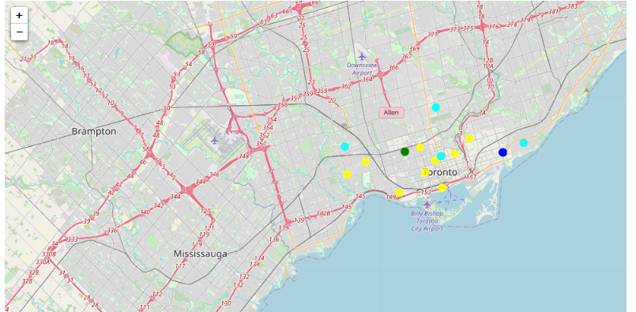
Indian Restaurant Clusters
Indian Restaurant Recommendations
Restaurant Type | Recommended Neighbourhood
Indian Restaurant | The Beaches , Runnymede The Junction, Weston- Pellam Park

Slide 8
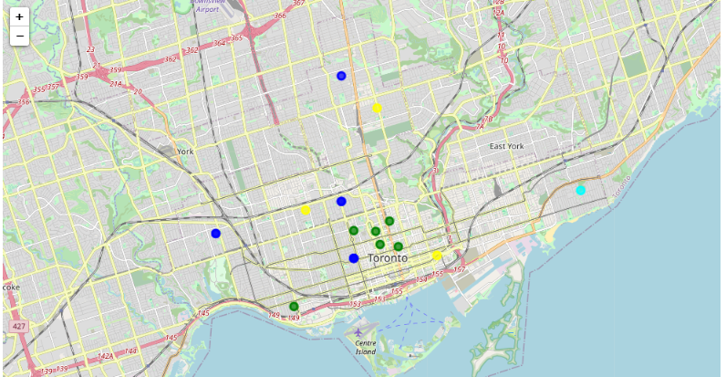
Mexican Restaurant Clusters
Mexican Restaurant Recommendations
Restaurant Type | Recommended Neighbourhood
Mexican Restaurant | Christie The Beaches

Slide 9
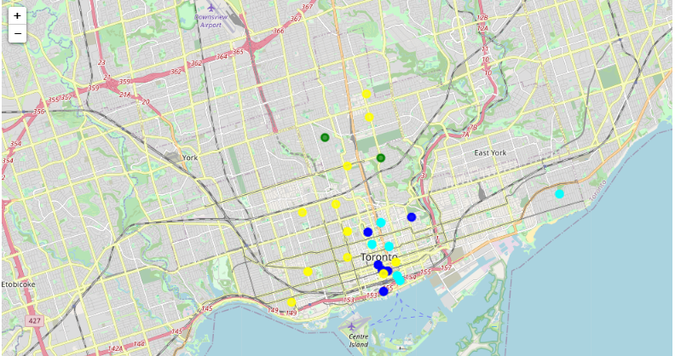
Japanese Restaurant Clusters
Japanese Restaurant Recommendations
Restaurant Type | Recommended Neighbourhood
Japanese Restaurant | Moore Park, Summerhill East'

Slide 10
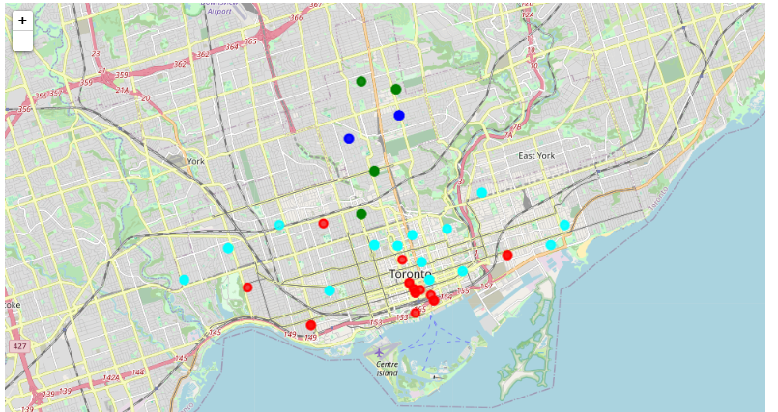
Italian Restaurant Clusters
Italian Restaurant Recommendations
Restaurant Type | Recommended Neighbourhood
Italian Restaurant | Kensington Market, Chinatown, Grange Park The Beaches Runnymede, The Junction, Weston- Pellam Park Carlton Village Moore Park, Summerhill East Forest Hill North & West, Forest Hill Road Park

Slide 11
Thank You

